Slide 1

A Container-Usage-Pattern-Based
Context Debloating Approach
for Object-Sensitive Pointer Analysis
Dongjie He, Yujiang Gui, Wei Li, Yonggang Tao, Changwei Zou, Yulei Sui, Jingling Xue
School of Computer Science and Engineering,
University of New South Wales, Australia
October 22, 2023
OOPSLA 2023
1
Notes:
Hello everyone, I am Dongjie, I come from the University of New South Wales.
In my presentation, I will introduce a new context-debloating technique for accelerating object-sensitive pointer analysis.
00:13.07

Slide 2
Pointer Analysis
Programs (in C/C++/Java, …) are full of pointers or references
Answer the following two problems
memory
memory
a
v
b
(1) What can a pointer point to?
(2) Can a and b be aliases?
OOPSLA 2023
2
Notes:
We know that Programs written in C/C++/Java are full of pointers or references.
Pointer Analysis answers two fundamental problems:
What memory locations can a pointer point to?
whether two pointers could be aliases. 00:39.61

Slide 3



Pointer Analysis
Programs (in C/C++/Java, …) are full of pointers or references
Answer the following two problems
Foundation of many Static Program Analysis
Implementations in many popular frameworks
memory
memory
a
v
b
(1) What can a pointer point to?
(2) Can a and b be aliases?
Compiler Optimization
Call-graph
Construction
Program
Verification
Program
Understanding
Bug Detection
…
Qilin
SVF
OOPSLA 2023
3
Notes:
Pointer analysis is the foundation of many static program analyses and has
implementations in many popular frameworks. 00:49.68

Slide 4
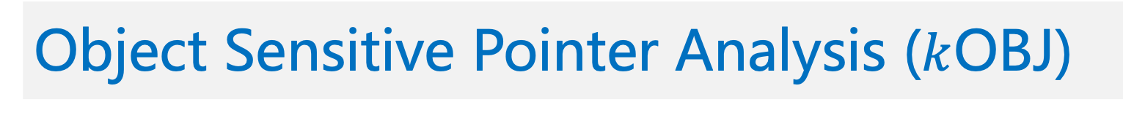
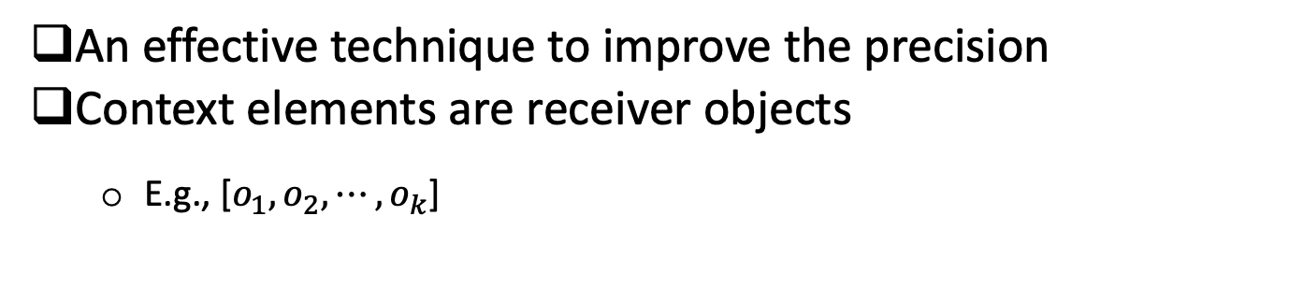
Object Sensitive Pointer Analysis ($k$OBJ)
An effective technique to improve the precision
Context elements are receiver objects
E.g., [$o_{1},o_{2},⋯,o_{k}$]
OOPSLA 2023
4
Notes:
Our paper focuses on object-sensitive pointer analysis.
Object sensitivity is an effective technique in improving the precision of Java Pointer Analysis.
In Object sensitivity, the elements of a calling context are receiver objects. Here, k is the number of context elements in a context. 01:18.02

Slide 5
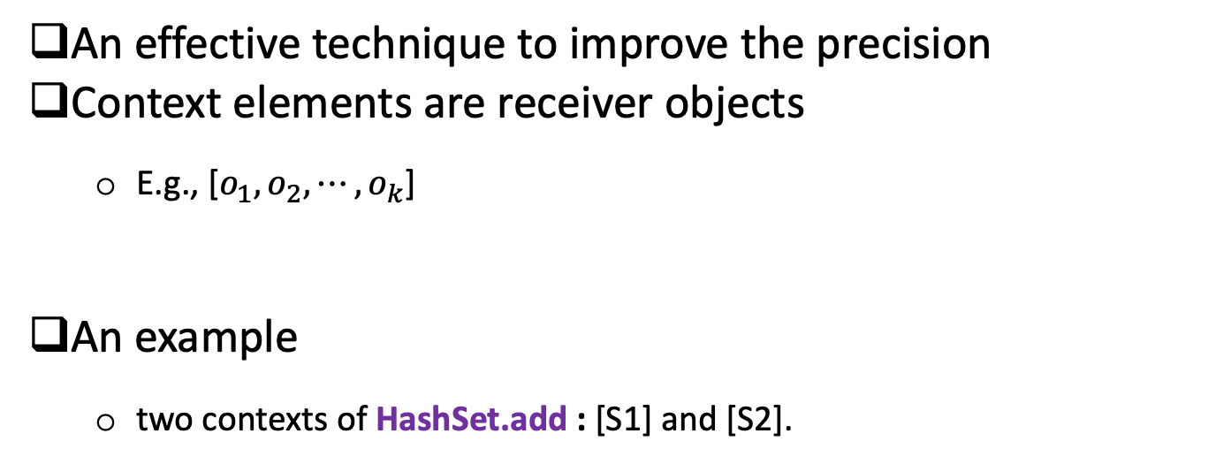
Object Sensitive Pointer Analysis ($k$OBJ)
An effective technique to improve the precision
Context elements are receiver objects
E.g., [$o_{1},o_{2},⋯,o_{k}$]
An example
two contexts of HashSet.add : [S1] and [S2].
1 HashSet s1 = new HashSet();// S1
2 HashSet s2 = new HashSet();// S2
3 s1.add(new Object()); // O1
4 s2.add(new Object()); // O2
S1
S2
this^{add}
In main(), analyzed under empty context []
OOPSLA 2023
5
Notes:
Let us see an example. In this code snippet, the add() method of the HashSet class is invoked twice in lines 3-4
with different receiver objects S1 and S2 created in lines 1-2 respectively.
So, HashSet.add has two calling contexts [S1] and [S2]. 1:50:32

Slide 6
Exponential Explosion Issue
Increasing $k$ makes $k$OBJ less Efficient or even Unscalable
OOPSLA 2023
6
OOPSLA 2023
7
Notes:
Generally, Increasing k could improve the precision of the object-sensitive pointer analysis.
But, it will make object-sensitive pointer analysis inefficient or even unscalable.
02:33.43

Slide 7

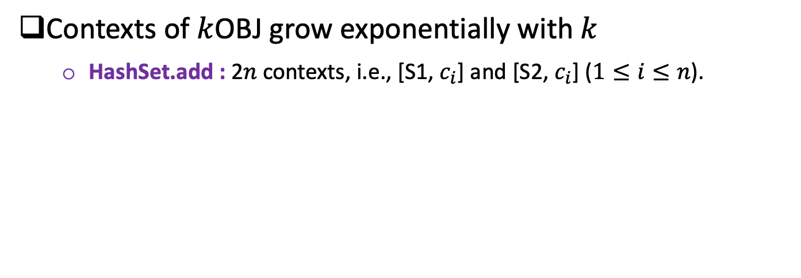
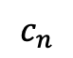
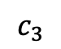
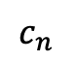
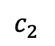
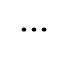
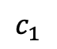
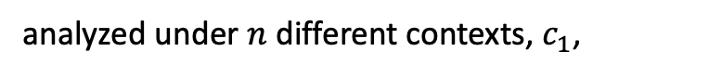
Exponential Explosion Issue
Increasing $k$ makes $k$OBJ less Efficient or even Unscalable
Contexts of $k$OBJ grow exponentially with $k$
HashSet.add : 2$n$ contexts, i.e., [S1, $c_{i}$] and [S2, $c_{i}$] ($1≤i≤n$).
1 HashSet s1 = new HashSet();// S1
2 HashSet s2 = new HashSet();// S2
3 s1.add(new Object()); // O1
4 s2.add(new Object()); // O2
$$c_{1}$$
$$c_{2}$$
$$c_{3}$$
$$⋯$$
$$c_{n}$$
S1
S2
analyzed under $n$ different contexts, $c_{1}$,
$$c_{n}$$
$$⋯$$
OOPSLA 2023
7
Notes:
The number of contexts of object-sensitive pointer analysis grows exponentially with k.
Suppose the code presented in the previous slides is analyzed under multiple contexts,
There will be 2n contexts of HashSet.add and HashMap.add() methods will be analyzed 2n times. 02:18.71

Slide 8
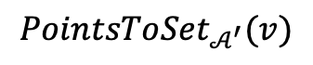
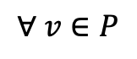
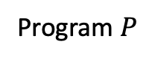
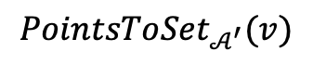
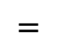
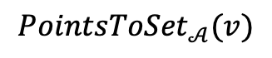
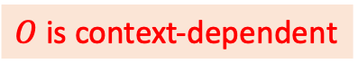
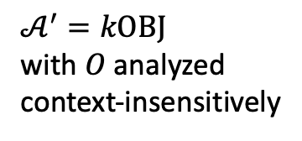
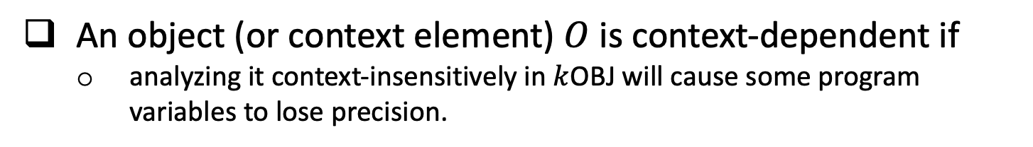
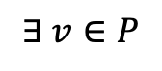
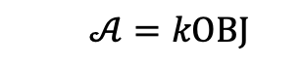

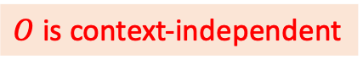
Review: Context Debloating
An object (or context element) $O$ is context-dependent if
analyzing it context-insensitively in $k$OBJ will cause some program variables to lose precision.
$O$ is context-independent
$${PointsToSet}_{𝒜}(v)$$
$$=$$
$${PointsToSet}_{𝒜^{′}}(v)$$
$$∀ v∈P$$
$𝒜^{′}=kOBJ$
with $O$ analyzed
context-insensitively
$$𝒜=kOBJ$$
Program $P$
$$∃ v∈P$$
$${PointsToSet}_{𝒜}(v)$$
$$≠$$
$${PointsToSet}_{𝒜^{′}}(v)$$
$O$ is context-dependent
OOPSLA 2023
8
Notes:
To address the exponential explosion issue,
In my previous publication, I proposed a novel technique called context debloating.
Let us briefly review the key idea of context debloating.
In kOBJ, context elements are objects. In a program, some objects are context-dependent while others are context-independent.
Here is an illustration of whether an object is context-dependent or not.
In short, An object or context element O is context-dependent if analyzing it context-insensitively in kOBJ will cause some program variables to lose precision.
04:04.66

Slide 9

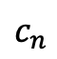
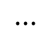
Review: Context Debloating
Key Observation:
Most (90%+) objects are Context-independent
E.g., S1 and S2 are locally used and independent of their contexts.
Allowing context combinations on them only increases analysis time
Context-dependent
1 HashSet s1 = new HashSet();// S1
2 HashSet s2 = new HashSet();// S2
3 s1.add(new Object()); // O1
4 s2.add(new Object()); // O2
CD
CI
Context-independent
analyzed under $n$ contexts, $c_{1}$,
$$⋯$$
$$c_{n}$$
OOPSLA 2023
9
Notes:
The key observation behind the context debloating technique is that
, in the real code, more than 90% of context elements are actually context-independent.
For example, S1 and S2 in the code snippet are used locally and are independent of their contexts.
Allowing context combinations on them only increases analysis time and memory resources without any benefits to the precision.
04:33.89

Slide 10
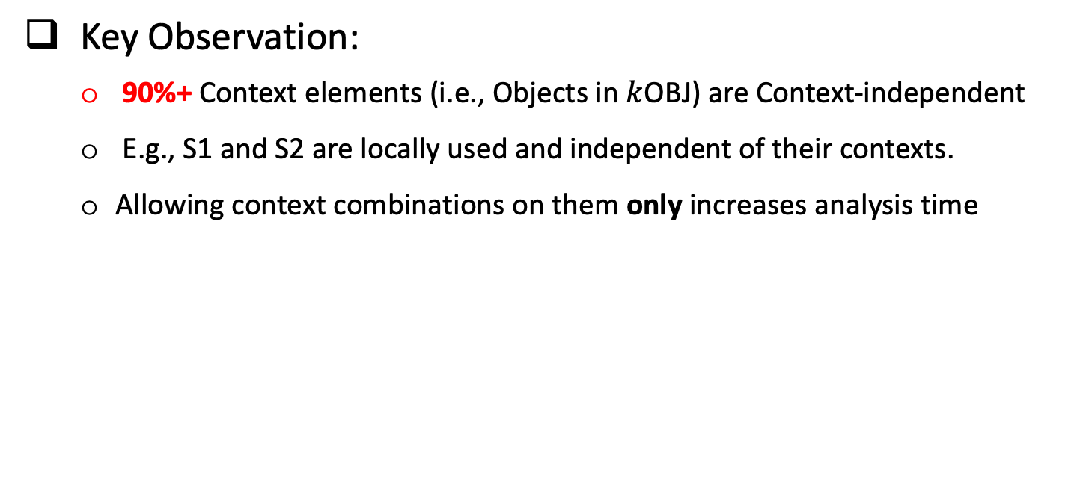
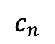
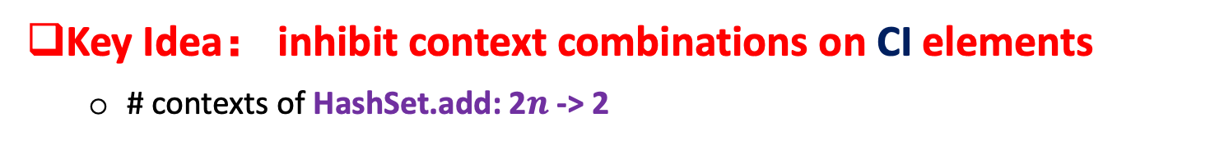
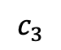
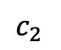
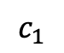
Review: Context Debloating
Key Observation:
90%+ Context elements (i.e., Objects in $k$OBJ) are Context-independent
E.g., S1 and S2 are locally used and independent of their contexts.
Allowing context combinations on them only increases analysis time
Context-dependent
1 HashSet s1 = new HashSet();// S1
2 HashSet s2 = new HashSet();// S2
3 s1.add(new Object()); // O1
4 s2.add(new Object()); // O2
CD
CI
Context-independent
analyzed under $n$ contexts, $c_{1}$,
$$⋯$$
$$c_{n}$$
Key Idea： inhibit context combinations on CI elements
# contexts of HashSet.add: 2$n$ -> 2
$$c_{1}$$
$$c_{2}$$
$$c_{3}$$
$$⋯$$
$$c_{n}$$
Precise and Efficient!
S1
S2
CI
OOPSLA 2023
10
Notes:
Thus, the key idea is to inhibit context combinations on context-independent elements.
Given that S1 and S2 are context-independent, the context combinations on them shown as the dotted lines are disallowed.
As a result, the number of contexts of HashSet.add() method decreased from 2n to 2.
This will make the analysis significantly more efficient while not losing any precision.
05:03.52

Slide 11
The Challenge in Context Debloating
How to precisely identify context-(in)dependent objects?
CD
CD
CI
CI
Ideal (Oracle)
Context-free-language(CFL)-based
CFL-based approach is undecidable (OOPSLA’19, TOPLAS’00)
Eagle, Over-approximation of CFL (OOPSLA’19)
selects almost all non-trivial CIs as CDs
Very limited speedups, e.g., 1.5X
CD
CI
Eagle
OOPSLA 2023
11
Notes:
The challenge in context debloating is how to precisely identify context-dependent and context-independent objects.
The Context-free-language-based approach is theoretically undecidable.
Eagle, which is an over-approximation of the CFL, selects almost all non-trivial context-independent objects as context-dependent,
making the technique less efficient in practice.
05:32.64

Slide 12
Context Debloating Approaches
Conch: approximates CFL with three linearly verifiable conditions
field-insensitive (still too conservative)
limits further performance improvement
CD
CI
Conch (ASE’21, TOSEM’23)
OOPSLA 2023
12
Notes:
The prior context debloating work named conch, approximates CFL with three linearly verifiable conditions.
Though it is already very efficient, it is field insensitive which limits further performance improvements.
05:53.96

Slide 13

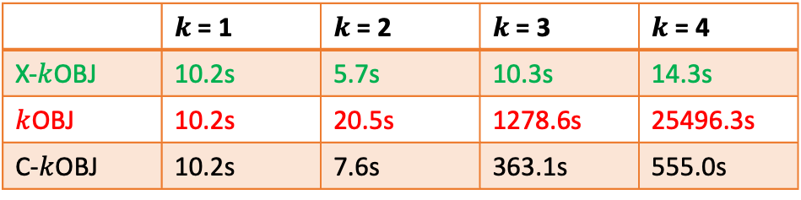
Context Debloating Approaches
Conch: approximates CFL with three linearly verifiable conditions
field-insensitive (still too conservative)
limits further performance improvement
CD
CD
CI
CI
Conch (ASE’21, TOSEM’23)
DebloaterX
DebloaterX
1-limited field-sensitive (e.g, O.f.*)
significant performance improvement with negligible precision loss
 | $k$ = 1 | $k$ = 2 | $k$ = 3 | $k$ = 4
X-$k$OBJ | 10.2s | 5.7s | 10.3s | 14.3s
$k$OBJ | 10.2s | 20.5s | 1278.6s | 25496.3s
C-$k$OBJ | 10.2s | 7.6s | 363.1s | 555.0s
luindex
OOPSLA 2023
13
Notes:
In this paper, we introduce another context debloating technique called DebloaterX.
The technique is 1-limited field-sensitive and could significantly improve the performance of kOBJ with only negligible precision loss.
06:12.04

Slide 14
DebloaterX: Our Approach
Identify context-dependent objects by usage patterns
We believe Patterns are finite!
OOPSLA 2023
14
Notes:
Our approach identifies context-dependent objects by usage patterns.
We believe that usage patterns of context-dependent objects in the real world are finite.
06:27.65

Slide 15
DebloaterX: Our Approach
Identify context-dependent objects by usage patterns
We believe Patterns are finite!
Three Container-Usage Patterns
Inner Containers
Factory-Created Containers
Container Wrappers
OOPSLA 2023
15
Notes:
In fact, we summarized the following 3 patterns in total.
06:33.83

Slide 16
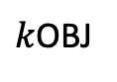
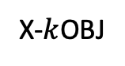
DebloaterX: Our Approach
Identify context-dependent objects by usage patterns
We believe Patterns are finite!
Three Container-Usage Patterns
Inner Containers
Factory-Created Containers
Container Wrappers
The above three Patterns are enough to preserve 99.8% of precision in the real world.
X-$k$OBJ
99.8%
$k$OBJ
100.0%
OOPSLA 2023
16
Notes:
Our evaluation shows the three patterns are enough to preserve 99.8% of precision in the practice.
06:44.47

Slide 17
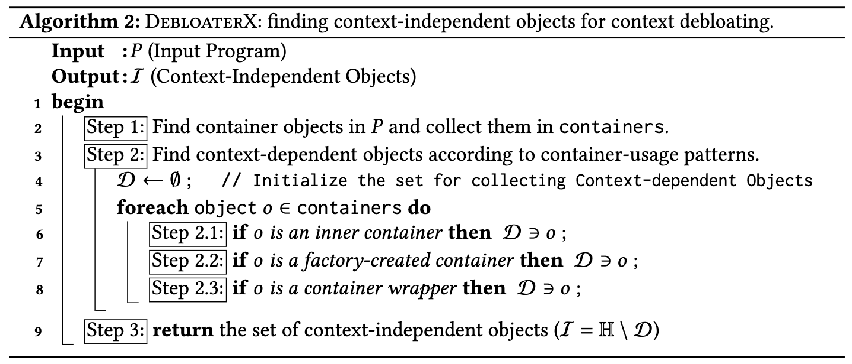

DebloaterX: Overall Algorithm
CI objects in will be used for context debloating
inhibit context combinations on CI elements
OOPSLA 2023
17
Notes:
From this slide, I am going to briefly introduce our approach.
Here is the overall algorithm of DebloaterX.
It consists of three steps and is very simple.
First, collect container objects in a program P.
Then for each container object, check whether its usage pattern belongs to any pre-defined usage patterns.
If yes, we select it to be a context-dependent object.
Finally, the context-independent objects are returned to the main pointer analysis and will be used for context debloating.
07:26.40

Slide 18

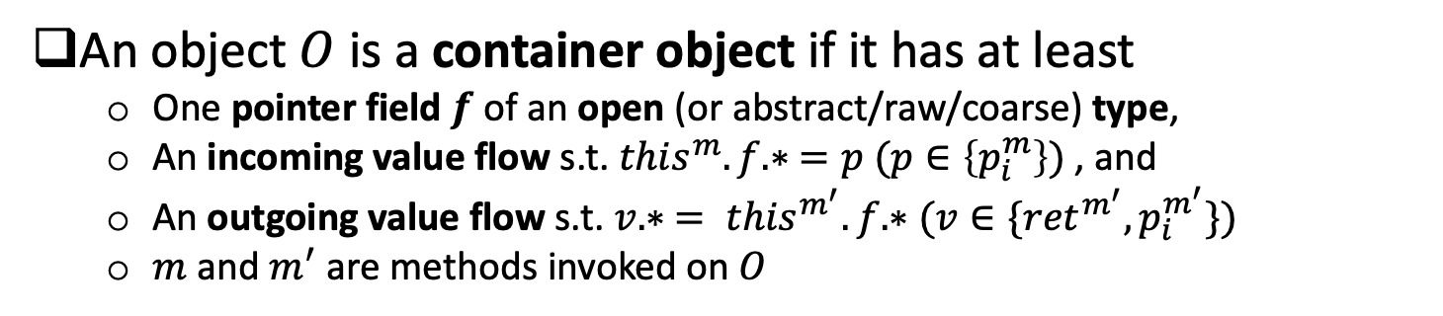
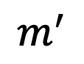
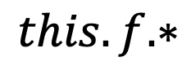
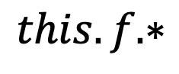
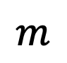
Containers
An object $O$ is a container object if it has at least
One pointer field $f$ of an open (or abstract/raw/coarse) type,
An incoming value flow s.t. ${this}^{m}.f.∗ =p (p∈\left\{p_{i}^{m}\right\})$ , and
An outgoing value flow s.t. $v.∗ = {this}^{m^{′}}.f.∗(v∈\{{ret}^{m^{′}},p_{i}^{m^{′}}\})$
$m$ and $m^{′}$ are methods invoked on $O$
$$O$$
points-to
$$m$$
points-to
$$m^{′}$$
IN
OUT
$$this.f.∗$$
$$this.f.∗$$
Aliases in the approximation of 1-limited field access path
OOPSLA 2023
18
Notes:
We first give the definition of containers.
An object O is a container object if it has at least one pointer field f of an open type and
An incoming value from a parameter and stored in the field f and an outgoing value flows on the field that flows to any return variable or parameters.

Slide 19
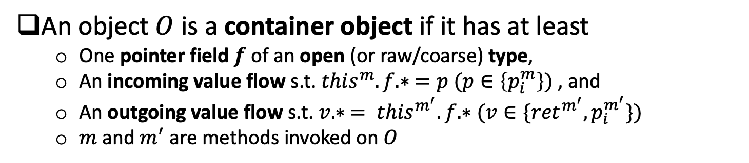
Containers
An object $O$ is a container object if it has at least
One pointer field $f$ of an open (or raw/coarse) type,
An incoming value flow s.t. ${this}^{m}.f.∗ =p (p∈\left\{p_{i}^{m}\right\})$ , and
An outgoing value flow s.t. $v.∗ = {this}^{m^{′}}.f.∗(v∈\{{ret}^{m^{′}},p_{i}^{m^{′}}\})$
$m$ and $m^{′}$ are methods invoked on $O$
An example
S1 is a container object
4 class HashSet { // in java.util;
5 HashMap map;
6 static Object g = new Object(); // O3
7 HashSet() { this.map = new HashMap(); // M }
8 void add(Object p) {
9 this.map.put(p, g); }
10 Iterator iterator() {
11 return this.map.keyset().iterator();
12 }
13 Object[] toArray() { …
14 }}
1 HashSet s1 = new HashSet();// S1
2 s1.add(new Object()); // O1
3 Object o1 = s1.toArray()[0];
IN S1.map
OUT S1.map
OOPSLA 2023
19
Notes:
Let us see an example.
The right code snippet defines a simplified HashSet in the JDK library. The left code snippet gives a usage case.
It first creates a HashSet object S1 and then adds Object O1 into the set. O1 is later loaded to o1 by calling toArray().
S1 is a container as it has a field map and an incoming value flow in the add() method and an outgoing value flow in the iterator() method.
The array object [O] created in line 15 is also a container object. The array indexes are modelled as a special field arr. At Line 15, there is an incoming value flow which stores the value in the HashSet to the array object. And though line 16 and line 3, there is an outgoing value flow that loads the content of the array object to o1.

Slide 20
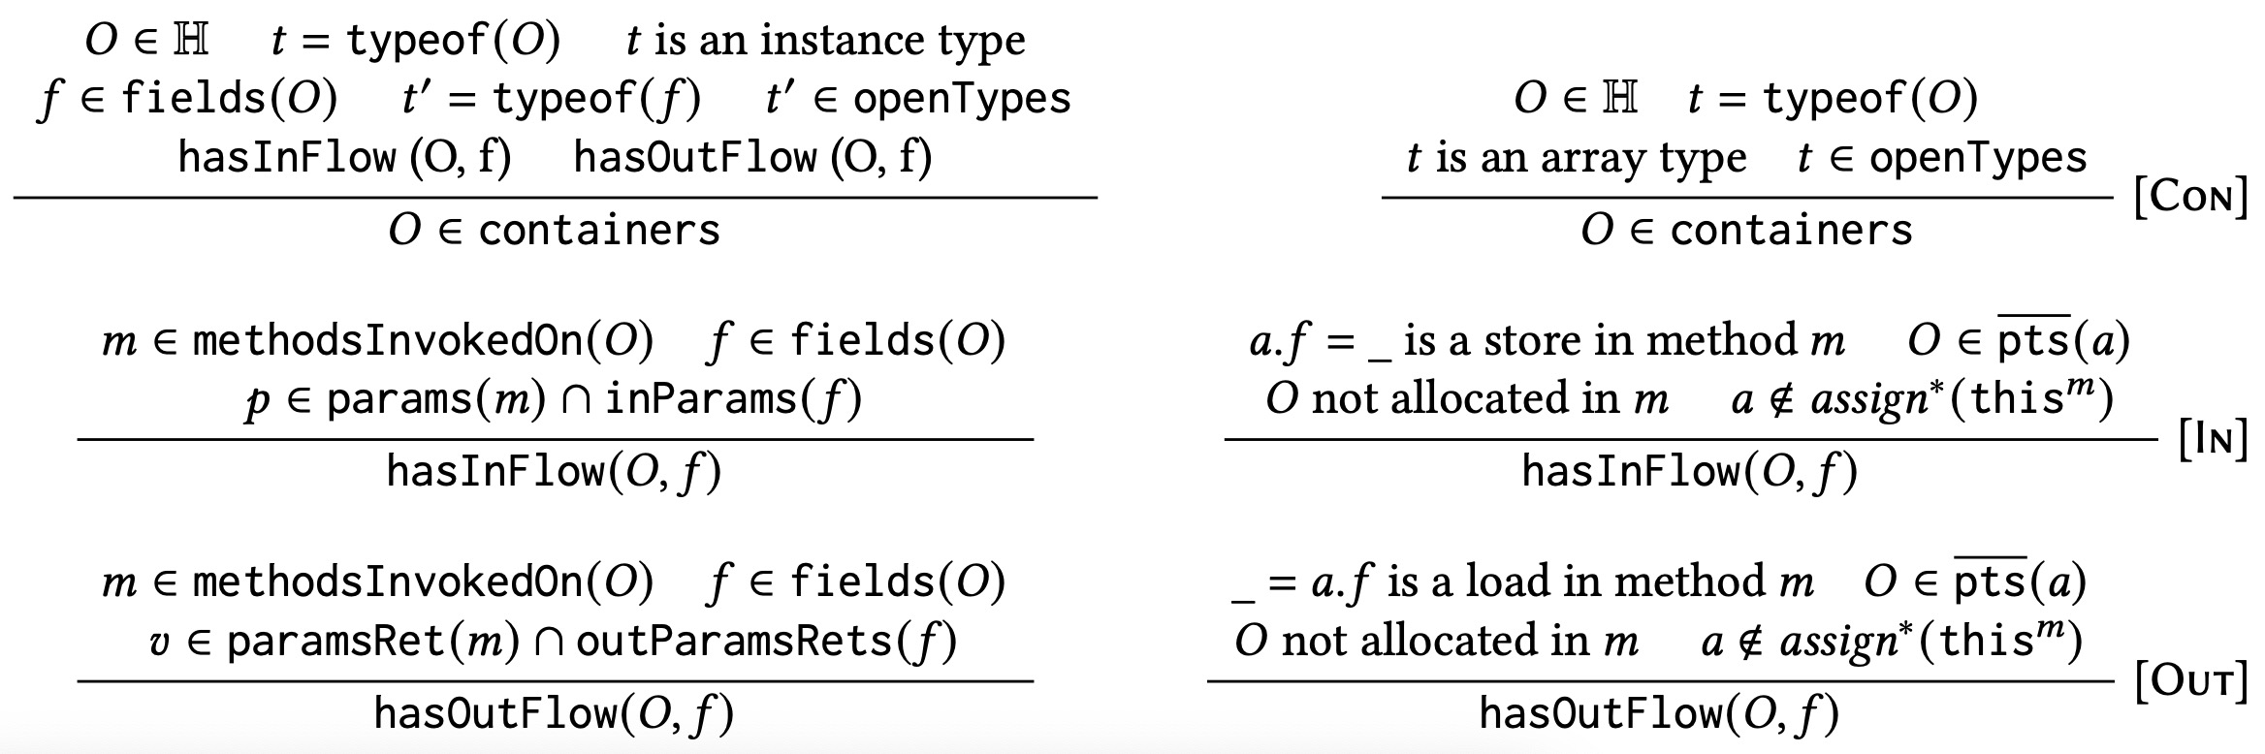
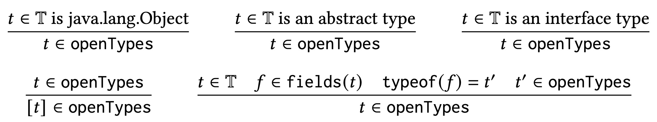
Containers
Rules for identifying Container Objects
Rules for Open Types
OOPSLA 2023
20
Notes:
Here are the rules for identifying container objects.
I am not going to introduce these rules in detail. If you are interested in them, you can read our paper.

Slide 21
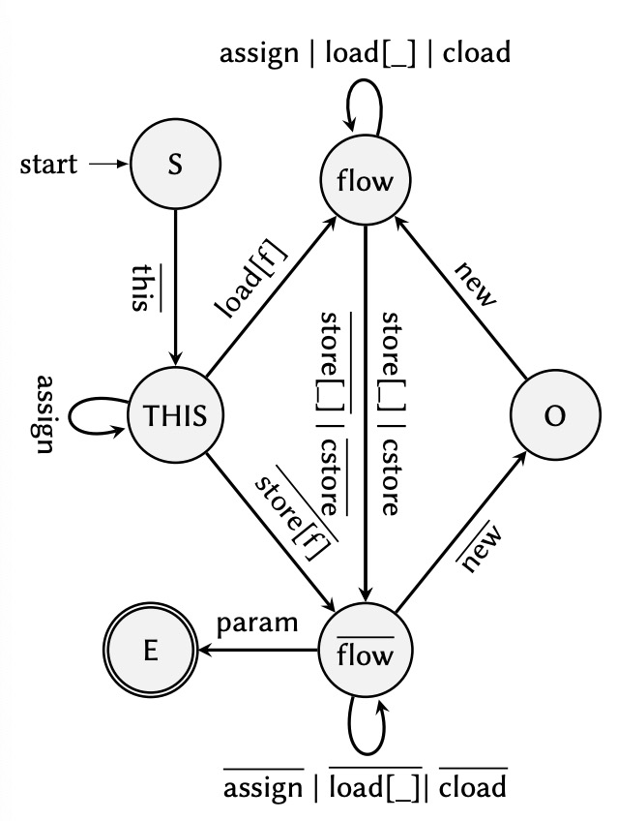
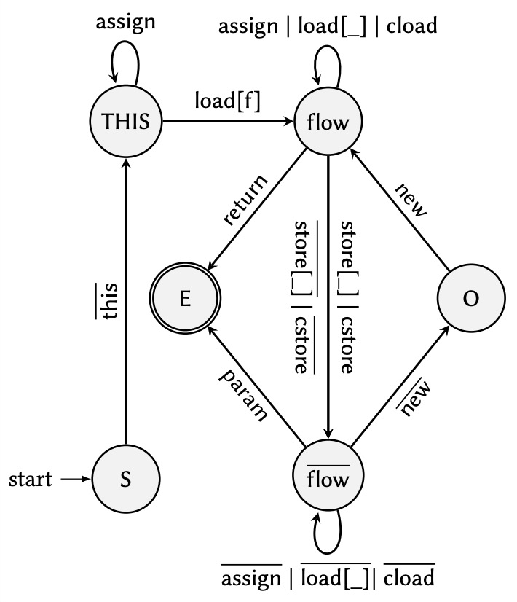
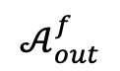
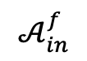
Containers
DFAs for computing incoming/outgoing value flows
$$𝒜_{in}^{f}$$
$$𝒜_{out}^{f}$$
1-limited field sensitive
OOPSLA 2023
21
Notes:
To compute the incoming and outgoing value flows, we have designed two automatons.
As you can see from the red circles, the automatons differentiate a specific field. Thus, they are 1-limited field sensitive.

Slide 22
Container-Usage Patterns
Pattern I: Inner Containers
Accessed by outer containers via a field
Used by outer containers for storing and retrieving data
1 class HashSet { // in java.util;
2 HashMap map;
3 static Object g = new Object(); // O3
4 HashSet() { this.map = new HashMap(); // M }
5 void add(Object p) {
6 this.map.put(p, g); }
7 Iterator iterator() {
8 return this.map.keyset().iterator();
9 }
10 }}
1
2
Inner containers are context-dependent
Distinguish the data stored by its different outer container objects
OOPSLA 2023
22
Notes:
From this slide, I briefly introduce the three usage patterns.
The first one is the inner container usage pattern.
An object is an inner container object if it can be accessed by the outer containers via a field and used by its outer containers for storing and retrieving data.
For example, the HashMap object M created in line 7 of this code snippet is associated with the field map and used to store and retrieve data via the add() and iterator() methods.
If M is analyzed context-insensitively, we could not distinguish the data stored by its different outer container objects.

Slide 23
Container-Usage Patterns
Pattern II: Factory-Created Containers
created in a static method
directly returned in the method
1
// in com.google.common.collect;
1 class Sets {
2 static HashSet newHashSet() {
3 return new HashSet(); // S
4 }}
2
Factory-created containers are context-dependent
Differentiate the data coming from different calling contexts
OOPSLA 2023
23
Notes:
Identifying factory-created containers is very simple.
A factory-created container is a container created in a static method and is directly returned in the method.
The factory-created containers could be used under different contexts.
Analysis them context-insensitively, will cause data coming from different contexts being conflated.

Slide 24
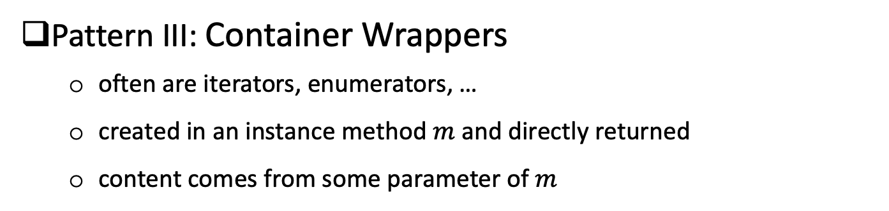
Container-Usage Patterns
Pattern III: Container Wrappers
often are iterators, enumerators, …
created in an instance method $m$ and directly returned
content comes from some parameter of $m$
3
1
1 class KeySet { HashMap m2;
2 KeySet(HashMap m4) { this.m2 = m4; }
3 Iterator iterator () {
4 HashMap m5 = this.m2;
5 return new KeyIterator(m5); // KI
6 } }
2
Container wrappers are context-dependent
Differentiate the wrapped content coming from different calling contexts
OOPSLA 2023
24
Notes:
Container wrappers in real programs are usually iterators and enumerators. They are often created in an instance method and directly returned.
The content of the objects must come from some parameters of the method m.
For this example code, the content of the KeyIterator object KI comes from the “this” parameter of the iterator() method.
The container wrappers have a close connection with the objects that they wrap. Thus, they have to be analyzed context-sensitively to reflect their different wrapped contents.

Slide 25
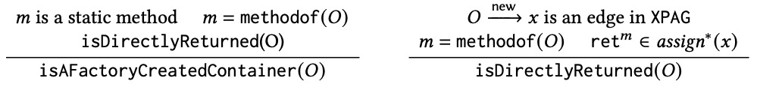
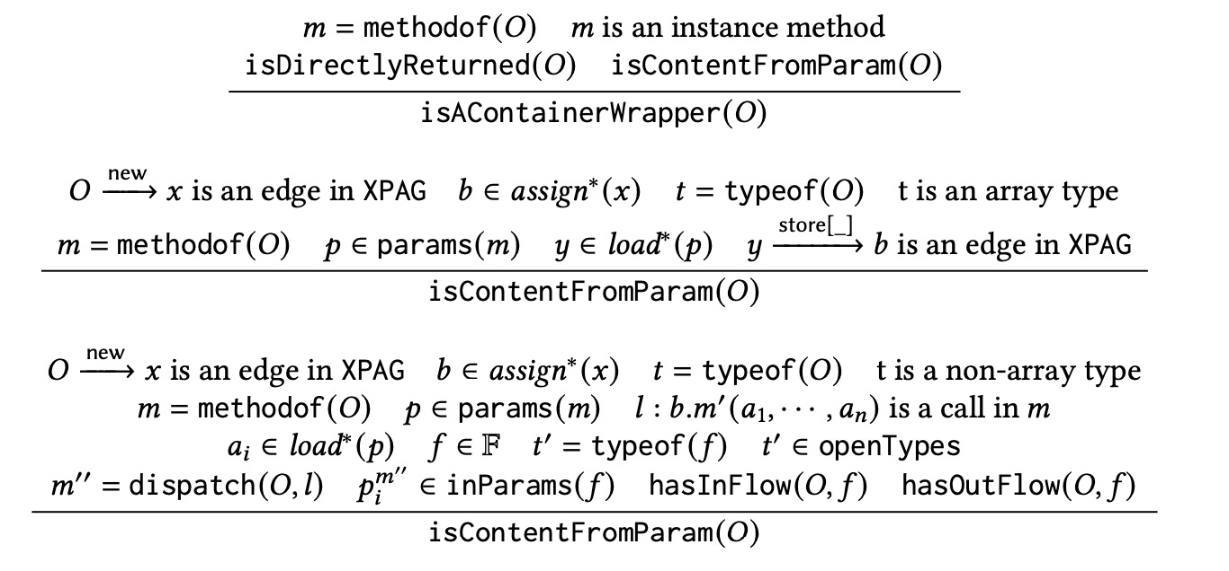
Rules for Identifying Usage Patterns
Rule for identifying inner containers
Rule for identifying factory-created containers
Rule for identifying container wrappers
OOPSLA 2023
25
Notes:
This slide just shows the rules to identify the usage patterns.

Slide 26

Workflow and Implementation
Workflow of DebloaterX-guided $k$OBJ
DebloaterX
Context-Insensitive
Pointer Analysis
Container Validator
Container Objects
Object-Sensitive
Pointer Analysis (kobj)
Objects Whose Contexts Will Be Debloated
Pattern-Based Context-Dependent Object Finder
Implementation (~1500 LOC in Java)
Source: https://github.com/DongjieHe/DebloaterX
Artifact: https://hub.docker.com/r/hdjay2013/debloaterx
Released in Qilin framework (https://qilinpta.github.io)
OOPSLA 2023
26
Notes:
Here is the workflow of our debloaterX-guided kOBJ.
We first use a context-insensitive pointer analysis to analyze a program.
With the imprecise points-to information, debloaterX selects a set of context-dependent objects based on the three usage patterns.
Finally, the context-independent objects are returned to the main pointer analysis for context debloating.
Our implementation is built on top of the Qilin framework and the source code and the artifact are both publicly available.

Slide 27




Evaluation
Benchmarks
5 dacapo 2006 benchmarks + JRE1.6
2 real-world applications + JRE1.6
5 dacapo-9.12 benchmarks + JRE1.8
Linux server with 512GB memory, 16 cores
Time budget: 12 hours
Metrics
Efficiency: analysis time
Precision: #fail-casts, #reachable, #call-edges, #poly-calls
JREs
JPC
OOPSLA 2023
27
Notes:
Here are the benchmarks, settings, and metrics used in our evaluation.
The benchmarks are from the two different versions of DaCapo benchmark set and two are from real-world programs.
The pointer analysis on these programs is quite memory-intensive, so we have used a machine with 512GB of memory.

Slide 28
Evaluation: Objects Identification
Containers: 26.6%, context-dependent objects: 7.6%
OOPSLA 2023
28
Notes:
Our evaluation finds that averagely 26.6% of objects in a program are containers and only about 7.6% of objects are context-dependent objects.

Slide 29
Evaluation: Objects Identification
Containers: 26.6%, context-dependent objects: 7.6%
Inner containers: 4.8% , factory-created containers: 1.2%, container wrappers: 1.7%
OOPSLA 2023
29
Notes:
The ratio of context-dependent objects identified by three patterns is respectively 4.8%, 1.2%, and 1.7%.
Note that the objects identified by the inner container pattern and the container wrapper pattern have small overlaps but are that not significant.

Slide 30

Evaluation: Efficiency
19.3x (150.2x) when k = 2 (3), faster than Conch and Zipper
The enabled Speedup of DebloaterX, Conch, and Zipper over 2OBJ
Better scalability
Scale 1 more than Conch, 6 more than Zipper
Scale 7 more than standard $k$OBJ
OOPSLA 2023
30
Notes:
Comparing with previous state-of-the-arts, our approach enables kOBJ run faster than Conch and Zipper and achieves better scalability than them.

Slide 31
Evaluation: Precision
Negligible precision loss (<0.2%), similar to Conch
Precise than Zipper (~4.5% loss)
The precision loss of DebloaterX, Conch, and Zipper-guided 2OBJ over 2OBJ
OOPSLA 2023
31
Notes:
In terms of precision, our approach losses less than 0.2% of precision which is very close to CONCH and is more precise than Zipper.

Slide 32



Summary
A new context debloating technique, DebloaterX
enable $k$OBJ to be more efficient than state-of-the-art while preserving nearly all of its precision.
Future work
Investigate performance issues on extremely larger programs, e.g., eclipse
Develop context-debloating techniques for other context-sensitivity
X-$k$OBJ: A precise yet efficient pointer analysis
OOPSLA 2023
32
Notes:
In summary, this paper introduces a new context debloating technique, DebloaterX.
It enables kOBJ to be more efficient than the state-of-the-art while preserving nearly all of its precision.
In the future, we still have many things to do on the thread of context debloating.

Slide 33
Q & A
Thank You!
OOPSLA 2023
33
Notes:
That’s all for the presentation.
Thank you for listening.
Any questions?

